Slide 1
Add Title
MSc Proposal
Student Name:
Registration No.
Supervisor:

Slide 2
Table of Contents
Introduction/Background
Literature Review
Problem Statement
Significance of Research
Aim and Objectives
Methodology
Expected Outcomes
Research Schedule
References

Slide 3
Introduction
Guidelines
The presentation time will be 7mins followed by 3mins Q/A session.
Avoid long paragraphs. Make use of bullet statements.
Figures and graphs should be of good quality and data should be readable.
Use APA Citation Style for in-text citation (https://www.mendeley.com/guides/apa-citation-guide/)
APA in-text citation style uses the author's last name and the year of publication, for example: (Field, 2005).

Slide 4
Literature review
Relevant current research that is close to your topic.
Different theories that may apply to your specific area of research.
Areas of weakness that are currently highlighted.

Slide 5
Problem Statement
Problem statement should be written in one statement with no bullets. Avoid adding figures in this slide. The authors can add figures in the background.

Slide 6
Significance of Research
Compare your work with the work that was done by others and pointing out the things that your study does which was never done before.
It can be a new methodology or a new design that sets the stage for new knowledge.
It could be an approach that purposefully attempts to add more understanding to the current knowledge base.

Slide 7
Aim and Objectives
The aim of the study is ____
Following are the research objectives:
____________
____________
____________

Slide 8
Methodology
Explain the methodology briefly. A great methodology slides explains the what, how, and why.
What method did you use for your research
Why did you choose it
How did you conduct it
The most effective way to aid understanding is by using graphics like flowcharts and tables.

Slide 9
Table format:
Table 1: Title of the table

Slide 10
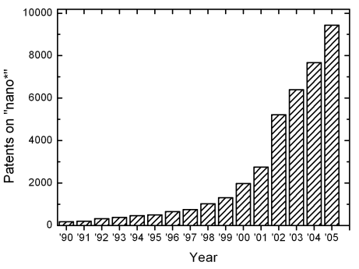
Figure format:
Figure 1: Title of the figure

Slide 11
Expected Outcomes
An explanation of how the proposal will address the needs shown in the Statement of the Problem.
An explanation of the benefits that will be realized if the proposal is accepted.
Most Expected Outcomes Sections are written in either the future tense (will) or with the conditional (would).

Slide 12
Research Schedule
Add Gantt chart of your research schedule
Download the Simple Gantt Chart template from the website:
https://templates.office.com/en-us/simple-gantt-chart-tm16400962

Slide 13
References
Use APA Reference style:
Derwing, T. M., Rossiter, M. J., & Munro, M. J. (2002). Teaching native speakers to listen to foreign-accented speech. Journal of Multilingual and Multicultural Development, 23(4), 245-259.
Krech Thomas, H. (2004). Training strategies for improving listeners' comprehension of foreign-accented speech (Doctoral dissertation). University of Colorado, Boulder.

